Slide 1

Design and analysis of algorithms (CSE 2012)
Prepared by
Dr.S.Jenicka
Associate professor senior grade 1
SCOPE-Analytics
VIT Vellore

Slide 2
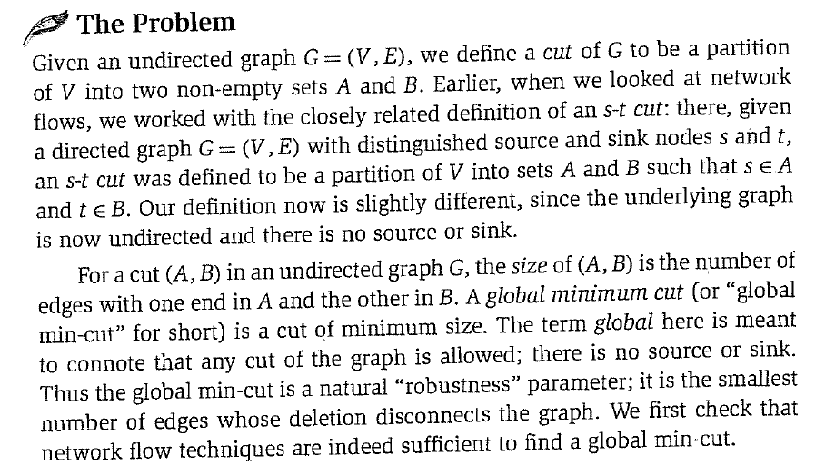
Randomized algorithm-Finding global minimum cut

Slide 3
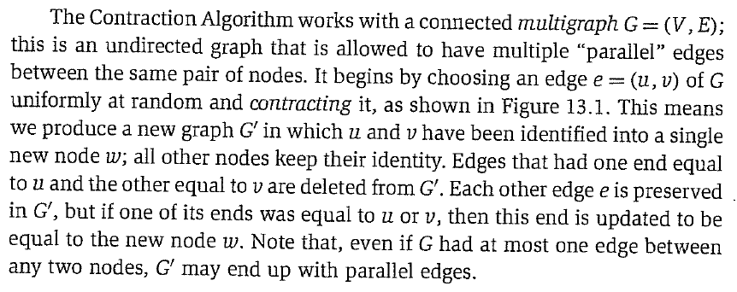
Contraction algorithm-Karger’s algorithm

Slide 4
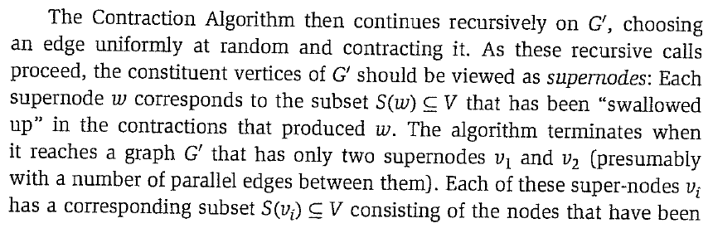

-Contd

Slide 5
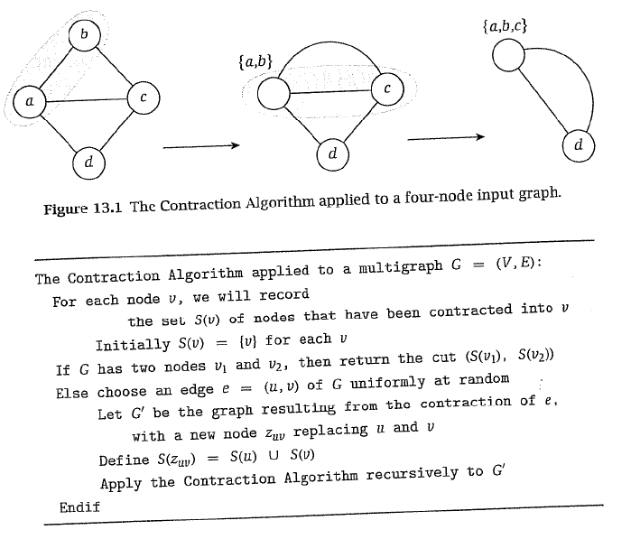
Example

Slide 6
-Contd
A cut (S,T) in an undirected graph G(V,E) is a partition of the vertices V into two non empty disjoint sets SUT=V. The cutset of a cut consists of the edges between the two parts. The size of a cut in an unweighted graph is the cardinality of the cutset (i.e) the number of edges (preserved) between the two parts.

Slide 7
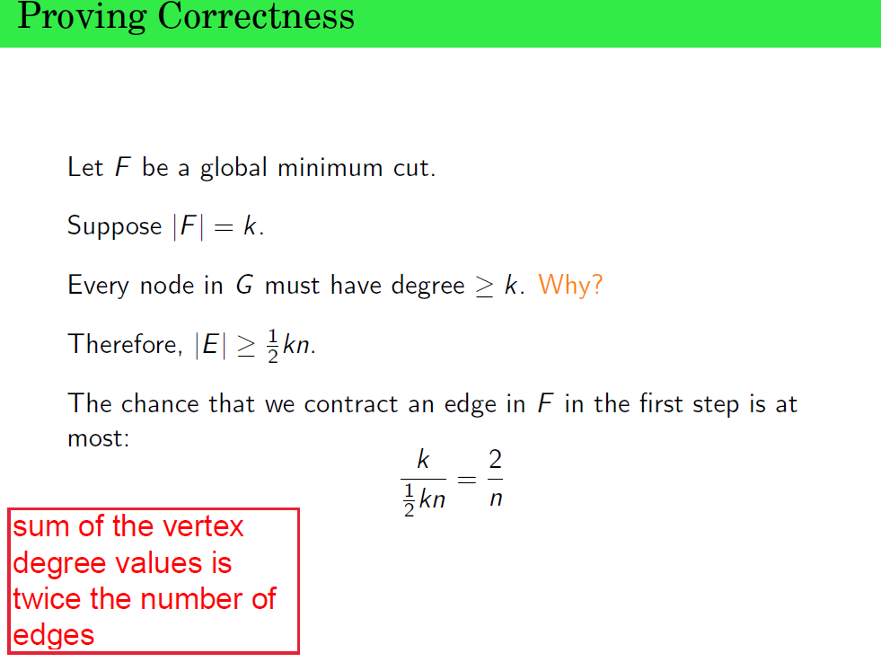
The cardinality of global minimum cut F is k which means that F has k edges that are preserved during termination.
The probability that one edge in F is contracted when the algorithm starts, is k/(kn/2).

Slide 8
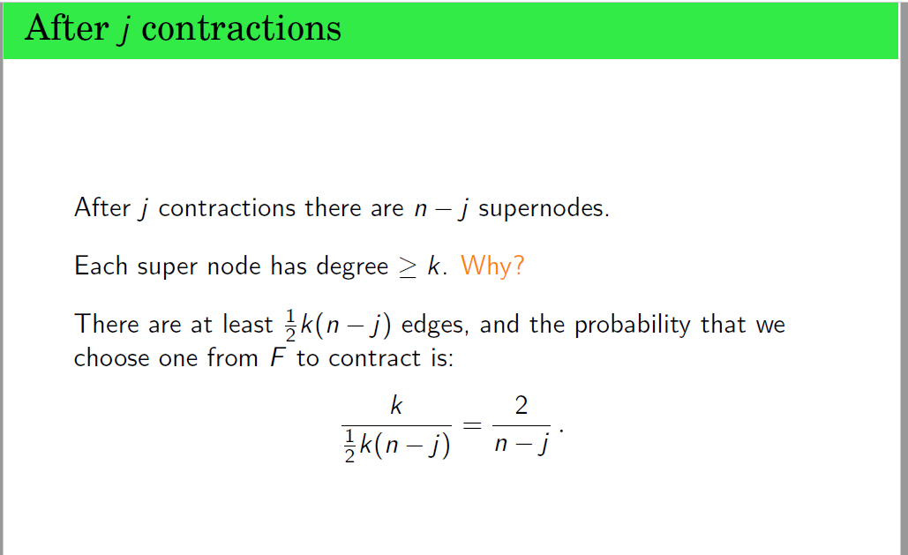
After j contractions, the number of supernodes becomes (n-j) in the above expression.

Slide 9
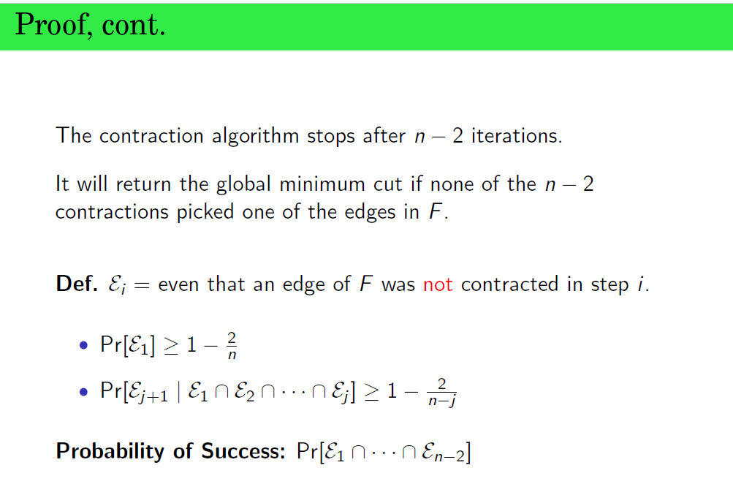
The algorithm stops after (n-2) edges are contracted. Because only two super nodes will remain. So before the last contraction happens, there will be only three supernodes (n=3) in the graph.

Slide 10
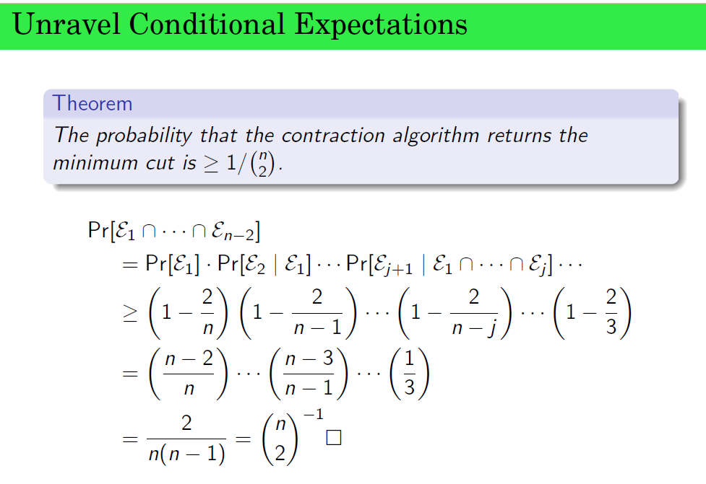
So the algorithm will return global minimum cut, if none of the contractions picked one of the edges in F.

Slide 11
-Contd
The cardinality of global minimum cut F is k which means that F has k edges that are preserved during termination.
The probability that one edge in F is contracted when the algorithm starts, is k/(kn/2).
After j contractions, the number of supernodes becomes (n-j) in the above expression.
The algorithm stops after (n-2) edges are contracted. Because only two super nodes will remain. So before the last contraction happens, there will be only three supernodes (n=3) in the graph.
So the algorithm will return global minimum cut, if none of the contractions picked one of the edges in F.

Slide 12
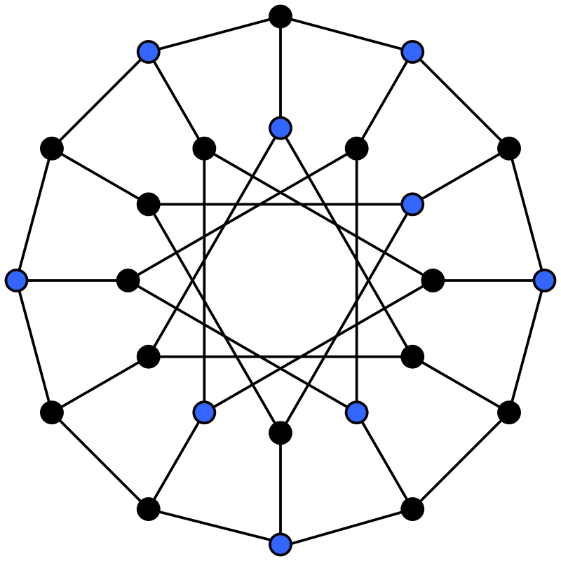
Maximum independent set
In graph theory, an independent set, stableset, coclique or anticlique is a set of vertices in a graph, no two of which are adjacent. Maximum independent set is an independent set of largest size in a given graph.

